Slide 1
Outer Joins

Slide 2
INNER Versus OUTER Joins
Inner Join
the join of two tables returning only matched rows is called an inner join.
Outer join
A join between two tables that returns the results of the inner join as well as the unmatched rows from the left (or right) tables is called a left (or right) outer join.
A join between two tables that returns the results of an inner join as well as the results of a left and right join is a full outer join.
Notes:
INNER Versus OUTER Joins
Joining tables with the NATURAL JOIN, USING, or ON clauses results in an inner join. Any unmatched rows are not displayed in the output. To return the unmatched rows, you can use an outer join. An outer join returns all rows that satisfy the join condition and also returns some or all of those rows from one table for which no rows from the other table satisfy the join condition.
There are three types of outer joins:
LEFT OUTER
RIGHT OUTER
FULL OUTER

Slide 3
Avengers Assemble (2012)
Actor | Role
Robert Downey Jr. | Tony Stark/Iron Man
Scarlett Johansson | Natasha Romanoff / Black Widow
Chris Evans | Steve Rogers / Captain America
Chris Hemmsworth | Thor
Mark Ruffalo | Bruce Banner / The Hulk
Chef (2014)
Actor | Role
John Favreau | Carl Casper
Robert Downey Jr. | Marvin
Scarlett Johansson | Molly
Oliver Platt | Ramsey Michel
Sofia Vergara | Inez
Stars of Avengers
Stars of Chef

Slide 4
Avengers INNER JOIN Chef (using actor)
MATCHES Between BOTH Tables
Actor Avengers | Role Avengers | Role Chef
Robert Downey Jr. | Tony Stark/Iron Man | Marvin
Scarlett Johansson | Natasha Romanoff / Black Widow | Molly

Slide 5
LEFT Outer Join
Everything in Avengers WITH A MATCH in Chef
PLUS
Rows in Avengers WITH NO MATCH in Chef with Role column given null in the output
Actor Avengers | Role Avengers | Role Chef
Robert Downey Jr. | Tony Stark/Iron Man | Marvin
Scarlett Johansson | Natasha Romanoff / Black Widow | Molly
Chris Evans | Steve Rogers / Captain America | Null
Chris Hemmsworth | Thor | Null
Mark Ruffalo | Bruce Banner / The Hulk | Null
Avengers LEFT OUTER JOIN Chef (using actor)

Slide 6
RIGHT Outer Join
Everything in Chef WITH A MATCH in Avengers
PLUS
Rows in Chef WITH NO MATCH in Avengers with Role column given null in the output
Actor Avengers | Role Chef | Role Avengers
John Favreau | Carl Casper | Null
Robert Downey Jr. | Marvin | Tony Stark/Iron Man
Scarlett Johansson | Molly | Natasha Romanoff / Black Widow
Oliver Platt | Ramsey Michel | Null
Sofia Vergara | Inez | Null
Oliver Platt | Ramsey Michel | Null
Chef RIGHT OUTER JOIN Avengers (using actor)

Slide 7
How do we find out who starred in BOTH MOVIES
(and only those who starred in both)
Including the roles they played in each movie in the output?

Slide 8
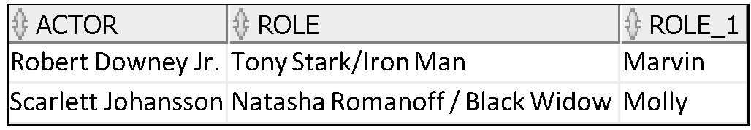
AVENGERS AND CHEF
INNER JOIN
Robert Downey Jr
Scarlett Johansson
AVENGERS
CHEF
select * from avengers
inner join chef using(actor);

Slide 9
How do we find out who starred in Avengers and output the role played
AND
IF they starred in Chef,
THEN output the role they played in Chef
ELSE the output null for that column?

Slide 10
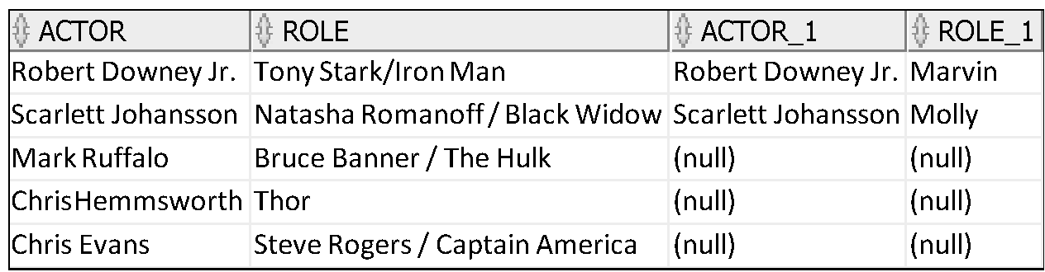
Left Outer Join
Mark Ruffalo
Chris Evans
Robert Downey Jr
Scarlett Johansson
Avengers and Chef
Everything from the 1st table EVEN IF there is nothing in the second
select * from avengers a LEFT OUTER JOIN chef c on a.actor=c.actor;
Chris Hemmsworth
AVENGERS AND CHEF
AVENGERS ONLY
Left

Slide 11
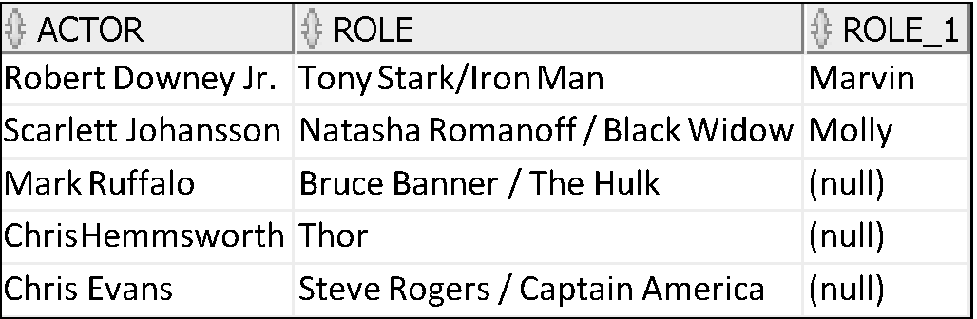
Left Outer Join
Mark Ruffalo
Chris Evans
Robert Downey Jr
Scarlett Johansson
Avengers and Chef
Everything from the 1st table EVEN IF there is nothing in the second
select * from avengers LEFT OUTER JOIN chef USING (actor);
Chris Hemmsworth
AVENGERS AND CHEF
AVENGERS ONLY
Left

Slide 12
We can achieve the same with Right Outer Join but from the perspective of the Chef table

Slide 13
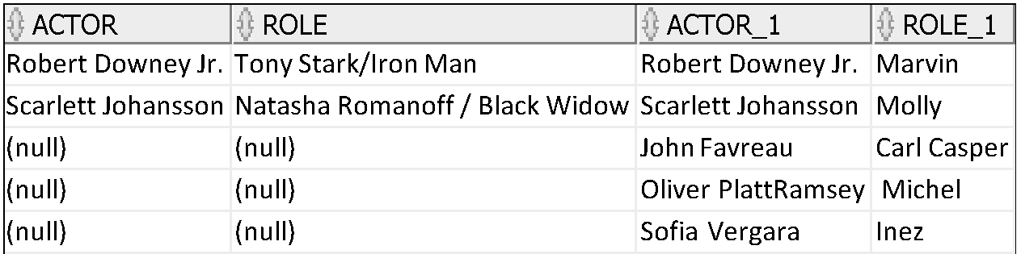
Right Outer Join
John Favreau
Avengers and Chef
Everything from the 2nd table EVEN IF there is nothing in the first
Robert Downey Jr
Scarlett Johansson
Oliver Platt
select * from avengers a RIGHT OUTER JOIN chef c on a.actor=c.actor;
Sofia Vergara
AVENGERS AND CHEF
Right
CHEF ONLY

Slide 14
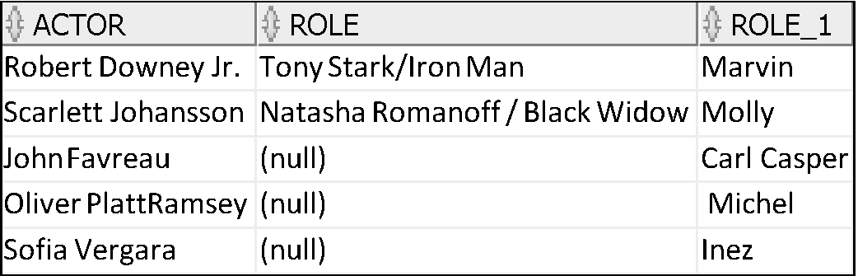
Right Outer Join
John Favreau
Avengers and Chef
Everything from the 2nd table EVEN IF there is nothing in the first
Robert Downey Jr
Scarlett Johansson
Oliver Platt
select * from avengers RIGHT OUTER JOIN chef USING (actor);
Sofia Vergara
AVENGERS AND CHEF
CHEF ONLY
Right

Slide 15
Suppose we had another table actors?
ACTORS
Chris Evans
Chris Hemmsworth
Mark Ruffalo
John Favreau
Oliver Platt
Sofia Vergara
Russell Crowe
Find Actors who did not star in Avengers?

Slide 16
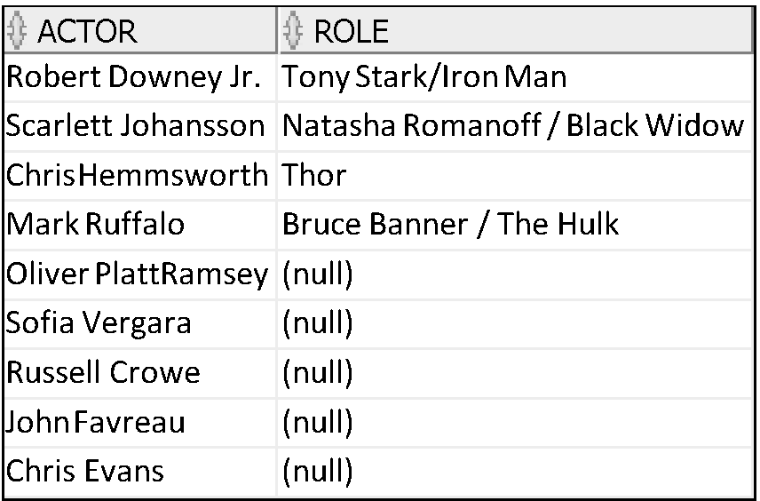
Right Outer Join
John Favreau
select * from avengers RIGHT OUTER JOIN actors USING (actor);
Robert Downey Jr
Scarlett Johansson
Chris Evans
Chris Hemmsworth
Mark Ruffalo
Oliver Platt
AVENGERS
Russell Crowe
ACTOR ONLY
Sofia Vergara
Right

Slide 17
How do we find out actors who starred in Avengers and everyone who starred in Chef (even if they were not in both)?

Slide 18
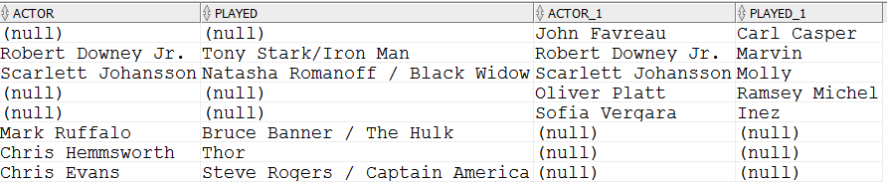
The Full Outer Join
Mark Ruffalo
John Favreau
Chris Evans
Robert Downey Jr
Scarlett Johansson
select * from avengers a FULL OUTER JOIN chef c on a.actor=c.actor;
Oliver Platt
Chris Hemmsworth
Sofia Vergara

Slide 19
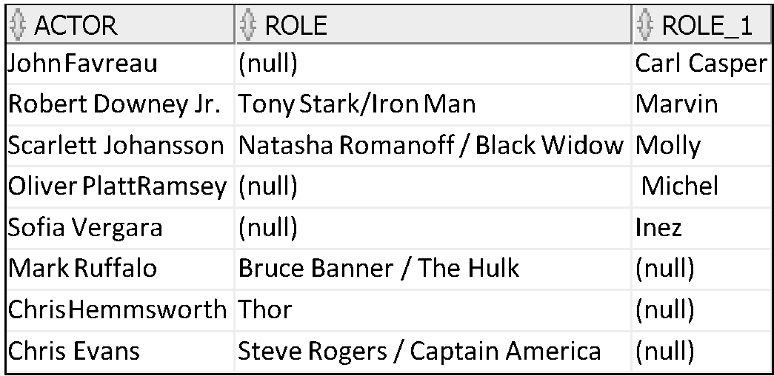
The Full Outer Join
Mark Ruffalo
John Favreau
Chris Evans
Robert Downey Jr
Scarlett Johansson
select * from avengers FULL OUTER JOIN chef USING (actor);
Oliver Platt
Chris Hemmsworth
Sofia Vergara

Slide 20
Projection and Restriction and GROUP
You can include a column list after the SELECT statement as you would normally
You can include a WHERE clause as you would normally
You can use GROUP functions as normal

Slide 21
Example

Slide 22
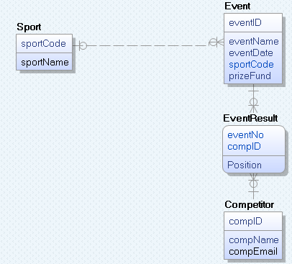
Olympics Database
The database we used in Week 10.

Slide 23
Suppose we want to find out details of all events?
And
For those that have results, include the results?

Slide 24
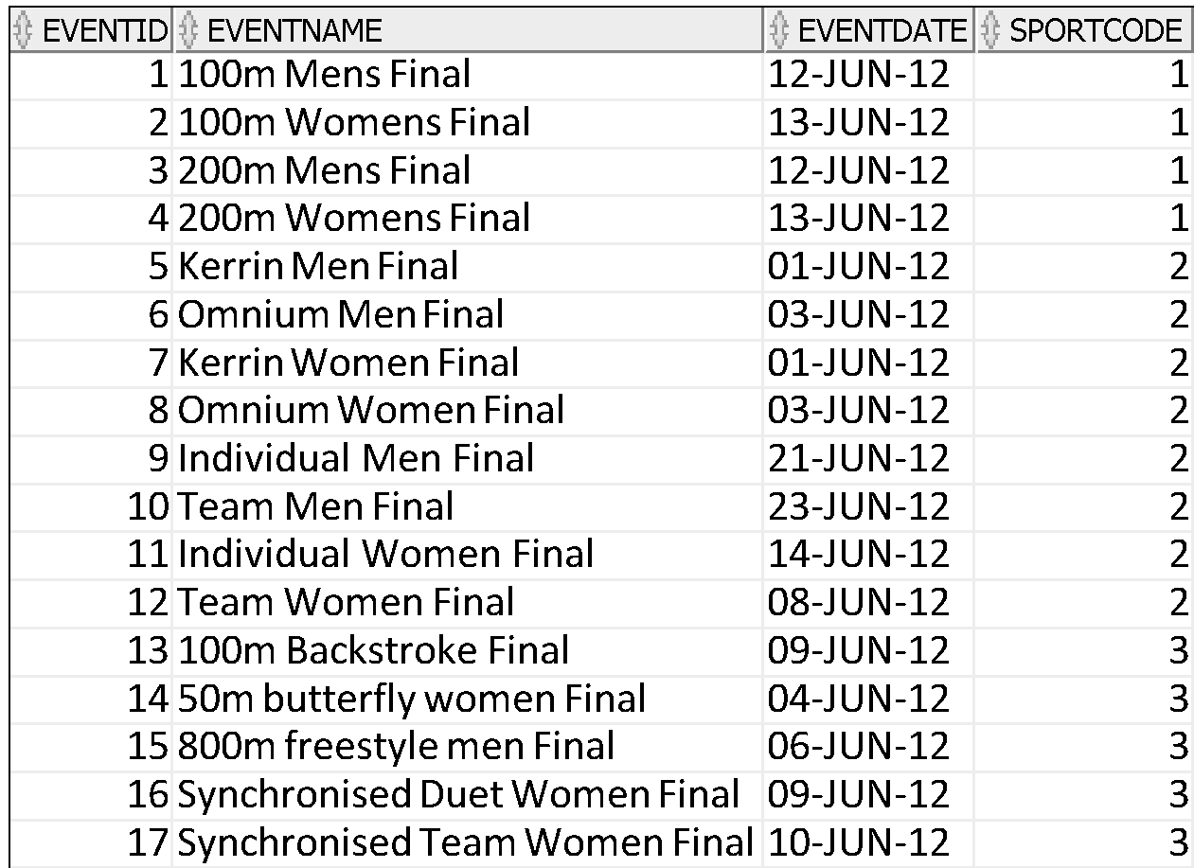
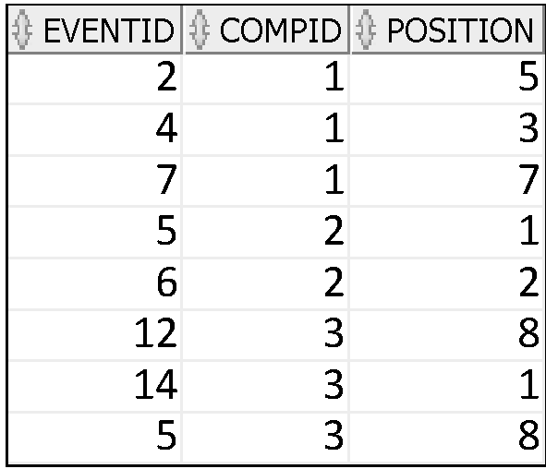
Looking at the data
These are the events
These are the results
There are no results for event 1,3,8,9, 10,11,13,15,16,17

Slide 25
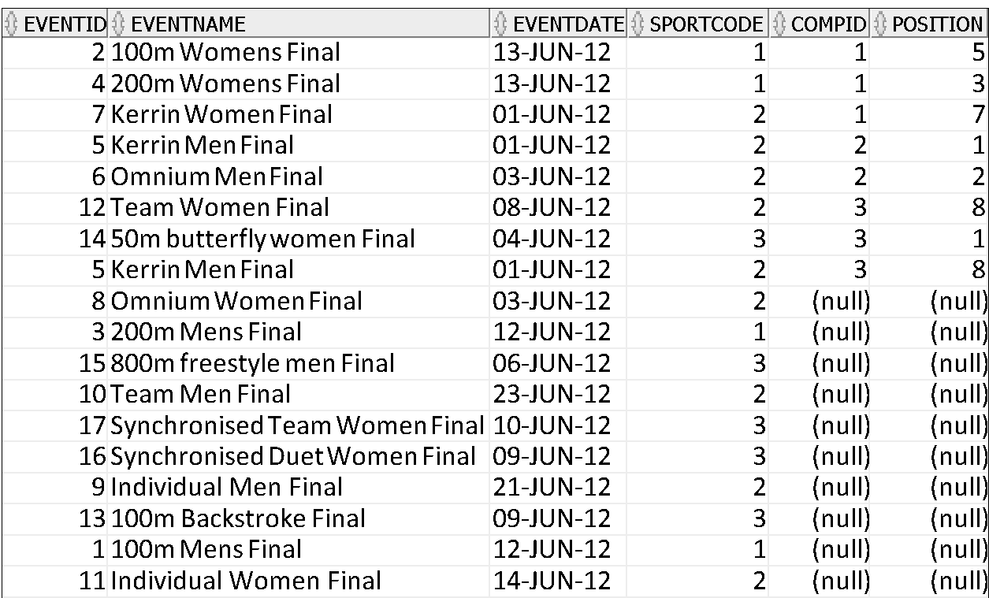
LEFT OUTER JOIN
select * from event
left outer join eventresult using (eventid);
For these events , the query works as an inner join would work
We get null for these columns for these events because there are no rows in the eventresult table for these events

Slide 26
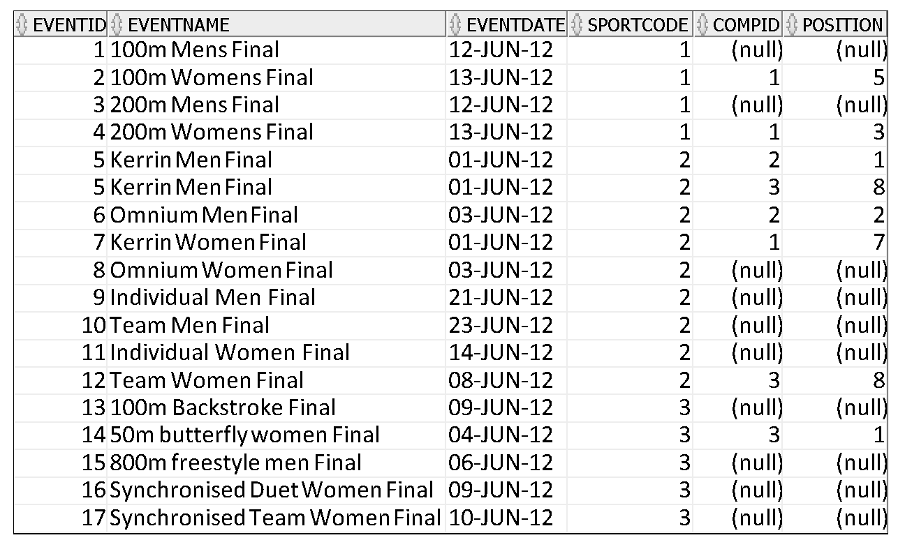
LEFT OUTER JOIN – Sorting Output
select * from event
left outer join eventresult using (eventid)
order by eventid;

Slide 27
Suppose we want to go further and include names of the competitors?

Slide 28
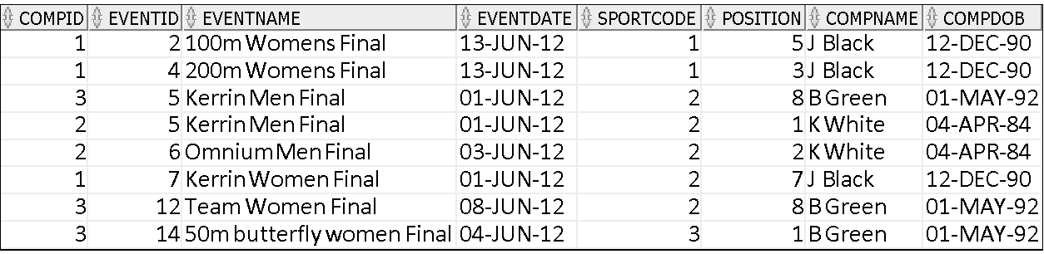
LEFT OUTER JOIN
We can’t just add an inner join at the end
select * from event
left outer join EVENTRESULT
using (eventid)
inner join competitor using (compid);
Where are all the nulls gone?

Slide 29
LEFT OUTER JOIN
We can’t just use an inner join
select * from event
left outer join EVENTRESULT
using (eventid)
inner join competitor using (compid);
Oracle will evaluate the joins in the order you specify them
So OUTER FIRST then inner
Some of our events don’t have any competitors so there are no matches to be found (there are no competitors with null for their compid) and so these rows will not be returned.

Slide 30
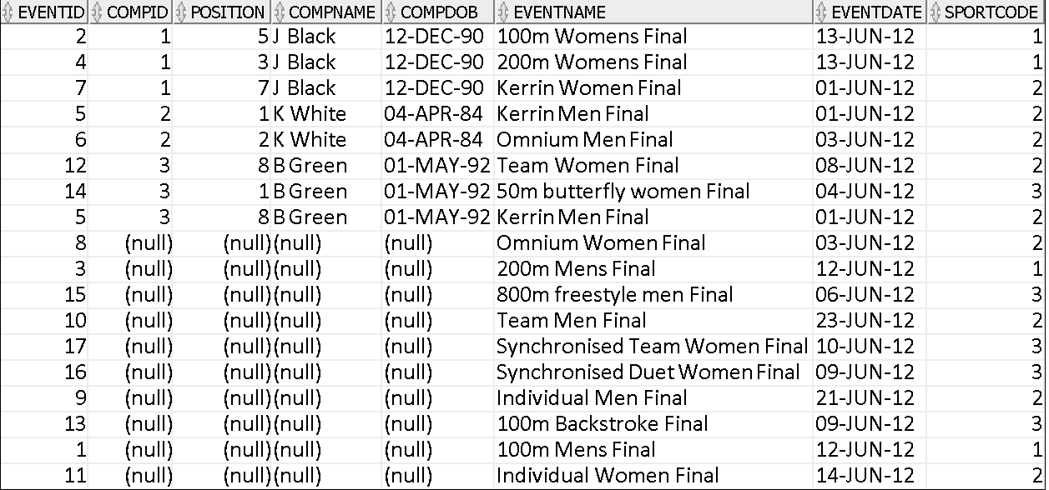
But we could do the following:
select * from eventresult
inner join competitor using (compid)
right outer join EVENT using (eventid);

Slide 31
What’s happening?
select * from eventresult
inner join competitor using (compid)
right outer join EVENT on eventid=eventno;
Here we are doing a right outer join between competitor and the resultset created from the inner join
The inner join is basically is adding the competitorname into the eventresult table which is then used in the right outer join

Slide 32
We could use a derived table with a left outer join
We use a derived table to handle the inner join with out left outer join
select event.eventid, event.eventname, event.eventdate, event.sportcode, compid, compname, position
from event
left outer join
(
select ER.eventid, ER.compid, compname, position
from eventresult ER
inner join competitor on ER.compid=competitor.compid
)
eventres on event.eventid=eventres.eventid;
Here we are doing an outer join with the temporary table created from the inner join
The select in ( ) basically is adding the competitorname into the eventresult table which is then used in the left outer join

Slide 33
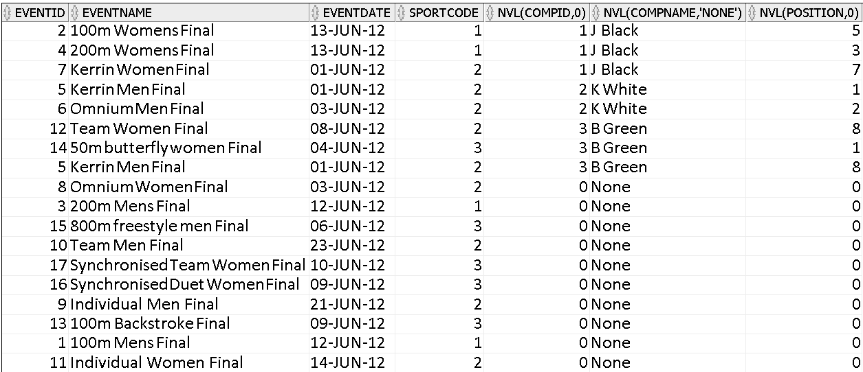
How would we change it so that rather than outputting nulls we get a 0?
select eventid, eventname, eventdate, sportcode, nvl(compid,0), nvl(compname,'None'), nvl(position,0) from eventresult
inner join competitor using (compid)
right outer join EVENT using (eventid);

Slide 34
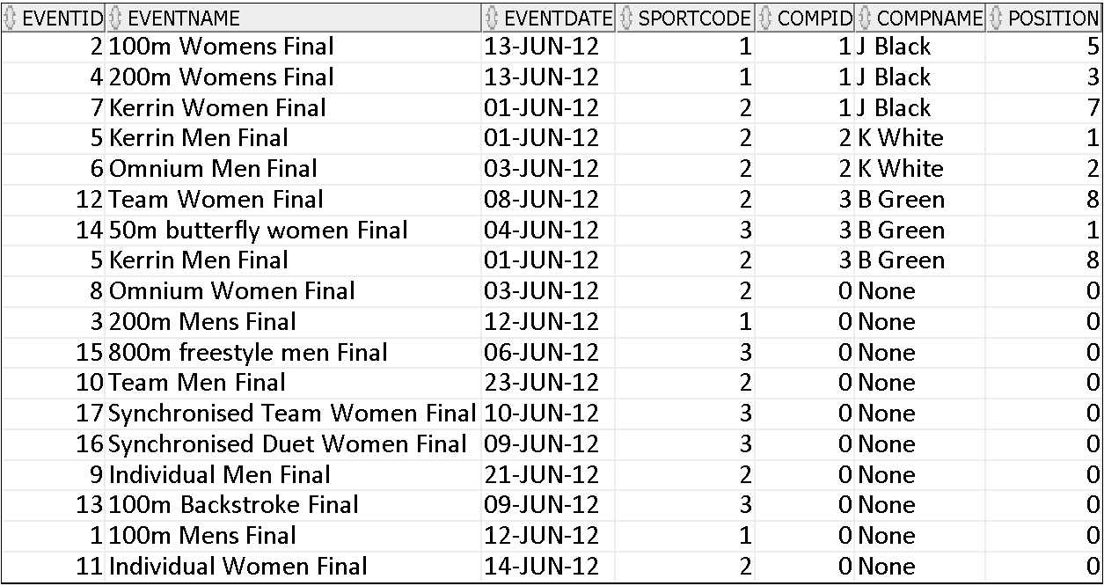
Changing the column names in the output…
select eventid, eventname, eventdate, sportcode, nvl(compid,0) as compid, nvl(compname,'None') as compname, nvl(position,0) as position
from eventresult
inner join competitor using (compid)
right outer join EVENT using (eventid);

Slide 35
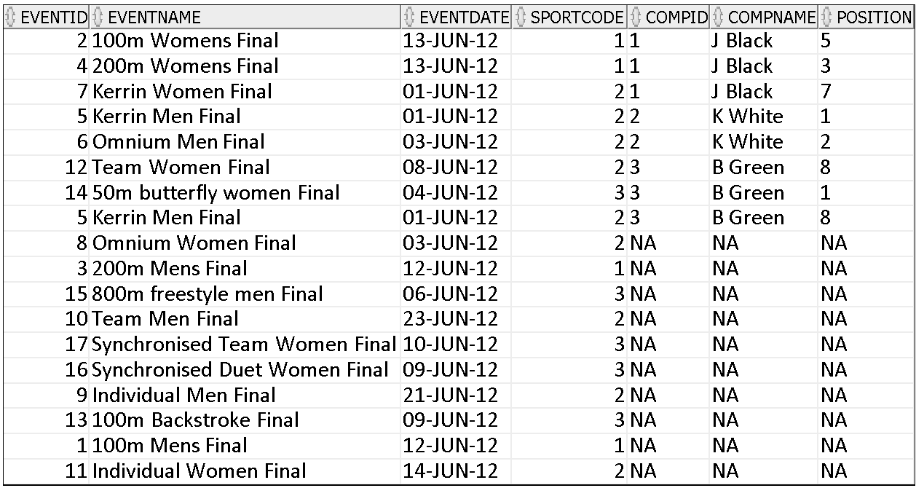
Changing the values output in nvl
select eventid, eventname, eventdate, sportcode,nvl(to_char(compid), 'NA') as compid, nvl(compname,'NA') as compname, nvl(to_char(position),'NA') as position from eventresult
inner join competitor using (compid)
right outer join EVENT using (eventid);

Slide 36
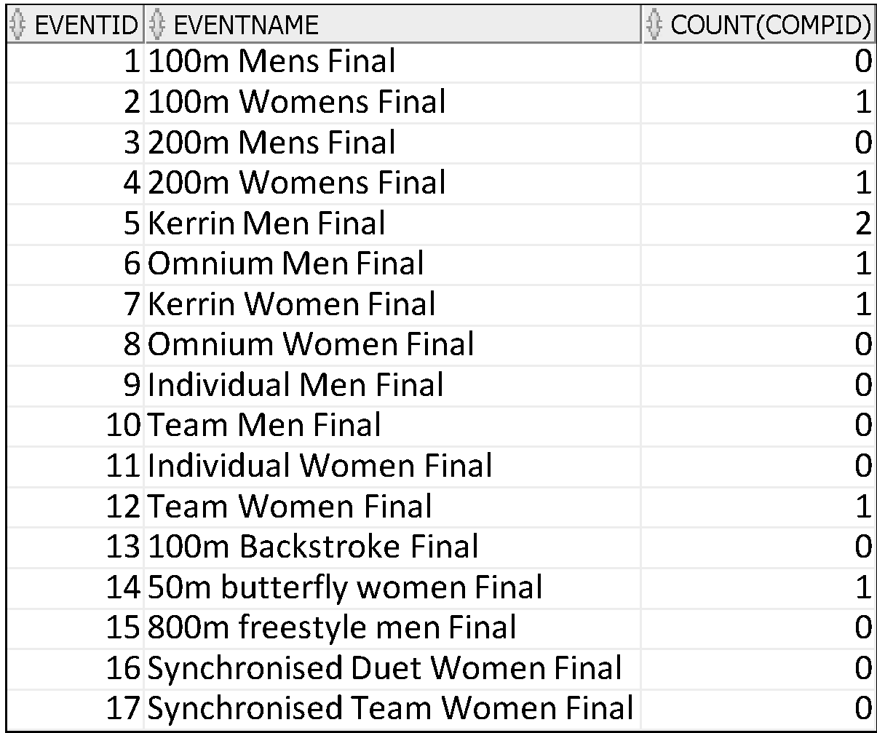
Calculating the number of results per event?
select eventid, eventname, count(compid)
from event
left outer join eventresult using (eventid)
group by eventid, eventname
order by eventid;

Slide 37
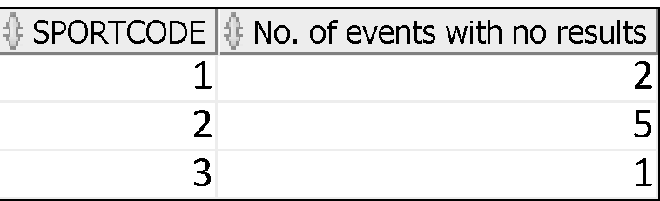
Calculating the number of results per sport?
select sportcode, count(compid) as "No. of events with no results"
from event
left outer join eventresult using (eventid)
group by sportcode;

Slide 38
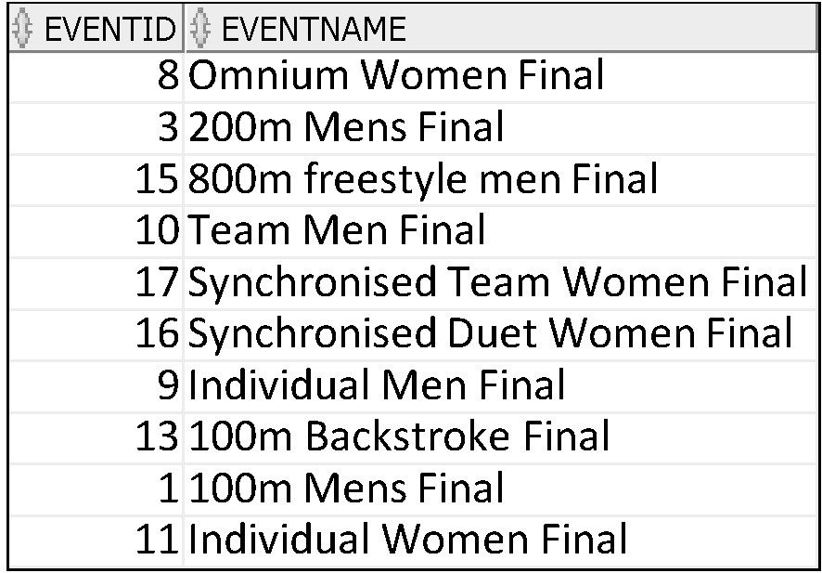
Only showing the events that do not have competitors….
select eventid, eventname from event
left outer join eventresult using (eventid)
where compid is null;

Slide 39
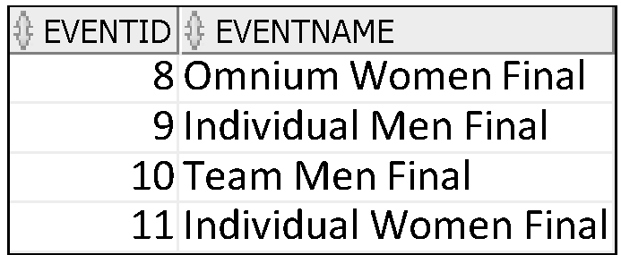
Only showing the events that do not have competitors for the sport Cycling
select eventid, eventname
from event
left outer join eventresult using (eventid)
where compid is null and sportcode = (select sportcode from sport where upper(sportname)='CYCLING');

Slide 40
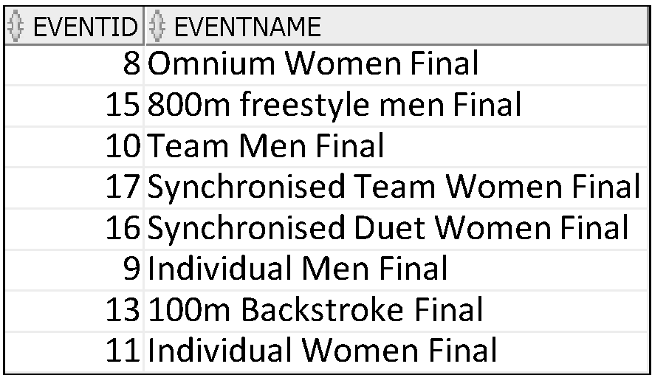
Only showing the events that do not have competitors for the sport Cycling or Aquatics
select eventid, eventname
from event
left outer join eventresult using (eventid)
where compid is null and sportcode IN (select sportcode from sport where upper(sportname)='CYCLING' or upper(sportname)='AQUATICS');

Slide 41
INNER Versus OUTER Joins
Inner Join
the join of two tables returning only matched rows is called an inner join.
Outer join
A join between two tables that returns the results of the inner join as well as the unmatched rows from the left (or right) tables is called a left (or right) outer join.
A join between two tables that returns the results of an inner join as well as the results of a left and right join is a full outer join.
Notes:
INNER Versus OUTER Joins
Joining tables with the NATURAL JOIN, USING, or ON clauses results in an inner join. Any unmatched rows are not displayed in the output. To return the unmatched rows, you can use an outer join. An outer join returns all rows that satisfy the join condition and also returns some or all of those rows from one table for which no rows from the other table satisfy the join condition.
There are three types of outer joins:
LEFT OUTER
RIGHT OUTER
FULL OUTER

Slide 42
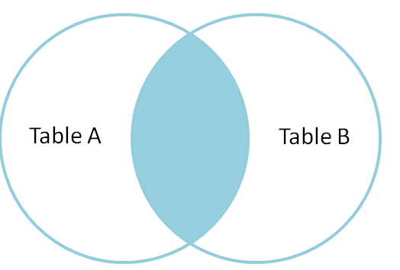
Inner Join
Return the set of records that match in both Table A and Table B
Can be natural, equi or non-equi join.
Difference is the columns you use to join and conditions you place on the join.
Equi joins depend on referential integrity (even if columns named differently) and equality
Non-Equi joins don’t.

Slide 43
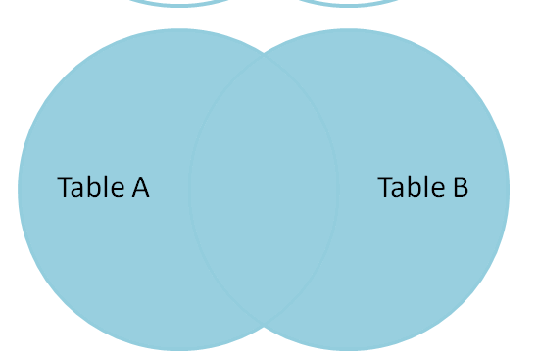
Full Outer Join
Return the set of all records in Table A and Table B, with matching records from both sides where available.
If there is no match, the columns from the missing side will be returned as null.
Can exclude the records we don't want from both sides via a where clause.

Slide 44
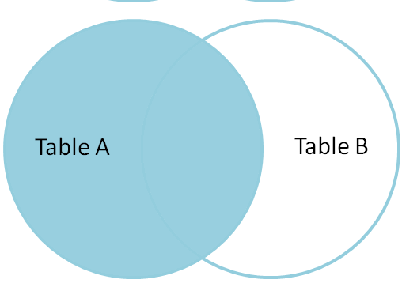
Left Outer Join
Return the set of records from Table A, with the matching records (where available) in Table B.
If there is no match, the columns from the right side will contain null.
Can exclude the records we don't want from the right side via a where clause.

Slide 45
Right Outer Join
Return the set of records from Table B, with the matching records (where available) in Table A.
If there is no match, the columns from the left side will contain null.
Table A
Table B
Can exclude the records we don't want from the right side via a where clause.

Slide 46
Some Practice

